Slide 1
Microsoft Power BI

Slide 2
Power BI Dev Camp – Session 4 Programing Datasets using the Tabular Object Model
Phil Seamark & Ted Pattison
Principal Program Managers
Customer Advisory Team (CAT) at Microsoft

Slide 3
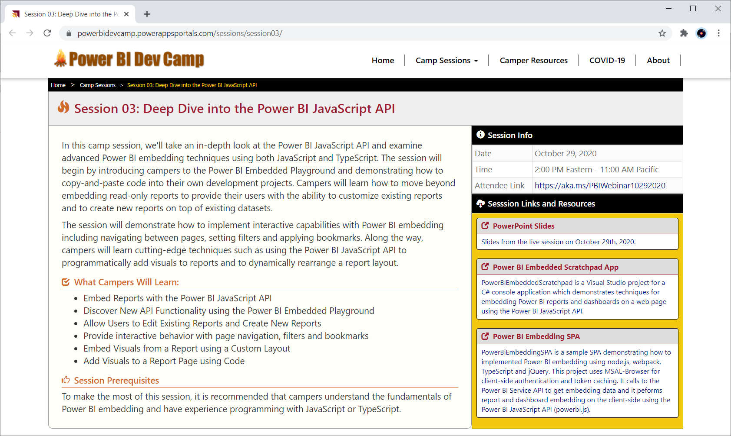
Welcome to Power BI Dev Camp
Power BI Dev Camp Portal - https://powerbidevcamp.net

Slide 4
Agenda
Hello World exercise
Add measures automatically
Query the model
Format your DAX
Build your own helper function

Slide 5
Tabular Object Model (TOM)
TOM is extension of Analysis Management Object (AMO) client library
created to support programming scenarios for tabular models
requires compatibility level 1200 and higher
TOM provides a programmatic way to handle administrative functions
creating models
importing and refreshing data
assigning roles and permissions
TOM requires two assemblies
Microsoft.AnalysisServices.Core
Microsoft.AnalysisServices.Tabular.dll

Slide 6
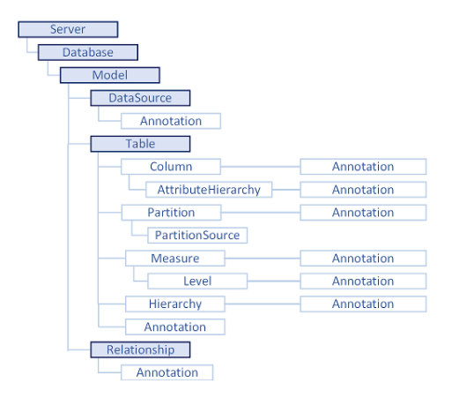
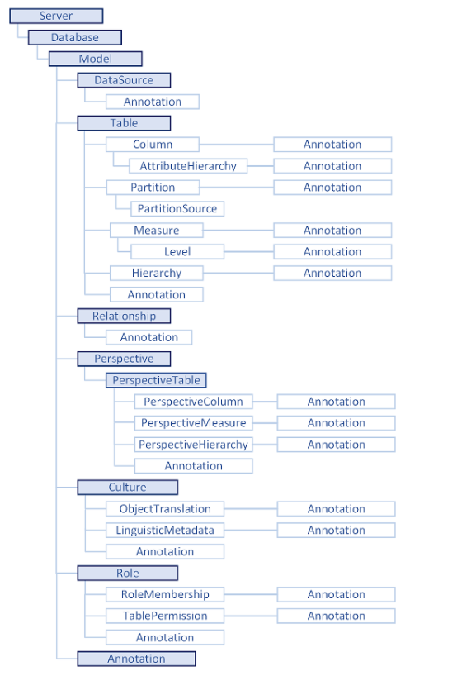

Slide 7
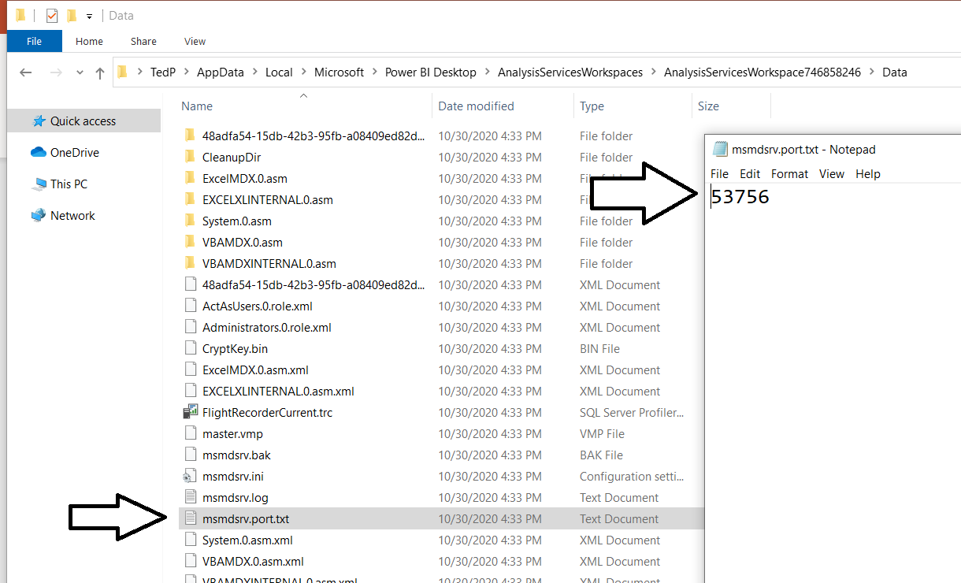
Find Port
For downloaded PBIDT
%LocalAppData%\Microsoft\Power BI Desktop\AnalysisServicesWorkspaces\Data\msmdsrv.port.txt
For PBIDT from Store
%userprofile%\Microsoft\Power BI Desktop Store App\AnalysisServicesWorkspaces\Data\msmdsrv.port.txt

Slide 8
Programming datasets
Using the Tabular Object Model (TOM)
Phil Seamark – PBICAT

Slide 9
Agenda
Hello World exercise
Add measures automatically
Query the model
Format your DAX
Build your own helper function

Slide 10
Exercise 1 – “Hello World”
Install SDK
Install Visual Studio Code
Create C# console project
Add TOM Client Libraries
Bonus Steps….

Slide 11
Exercise 2 – Auto Measures
Iterate through all tables and columns
Identify numeric columns
Create an “SUM OF” explicit measure for each column
Update AS annotations to keep track

Slide 12
Exercise 3 – Query the model
Use the “other” client library (AMOMD)
Execute a DAX expression against the model
Display the results on the screen
Bonus code, to create measures based on results

Slide 13
Exercise 4 – Format your DAX
Iterate through a model
Identify any DAX expression
Check if it is formatted – using a HASH stored in annotation
Send unformatted DAX to daxformatter.com
Update the model
Configure as an external tool

Slide 14
Exercise 5 – Helper tool
Interactive tool
Use as an external tool
Run queries
Perform bulk operations not easy to do in other tools

Slide 15
Summary – Programming with TOM
Great for automating tasks
Super Flexible
You should use Tabular Editor and DAX Studio first
But scripting is fun
Can create an entire database from scratch

Slide 16
Questions

